Slide 1
Topic 5: More on Persona, Scenario & HTA (Part 3)
SECV2113 Human-Computer Interaction
Faculty of Computing
Universiti Teknologi Malaysia

Slide 2
CREATING A PERSONA
01
TASKS ANALYSIS
02
WRITING A SCENARIO
03

Slide 3
CREATING
A PERSONA

Slide 4

Recap: What is a Persona?
A persona is a fictional character representing a major user group for a system being designed.
Captures the primary needs and expectations of key user segments.
Derived from user background, tasks, behaviors, attitudes, and motivations.
Informed by user interviews.
Documented in a concise, CV-style format.
Persona development is a relatively fast process.

Slide 5
Why are Personas Needed?
Traditionally user-centred design involved researching the needs of as many users as possible and collecting all of their requirements. This resulted in a long list of needs with no sense of priority. This lack of direction typically translated into designs that tried to serve all users but ended up serving no user particularly well.
Creating Personas allow you to identify discrete sets of users and create typical users to represent each group.

Slide 6
Benefits
Simplifies design decision-making.
Clarifies persona behaviours and goals.
Prevents assumptions about users.
Ensures diverse user needs are represented.
Avoids designing for wants instead of actual needs.
Enables ongoing design evaluation against personas.
Resolves design disagreements by referencing personas.

Slide 7
Limitations
Personas must address a specific design problem.
They are not reusable across different projects.
Context-specificity is critical.
Behaviours and goals must align with the domain.
Unique personas are required for each product.

Slide 8
How to Create a Persona?
Collect background data from your target users
Take primarily tasks, behaviour, goals, attitudes and environment into account
  Use empathy map
Add personal and motivational details
Make the personas come to life by including real photos
Check back with different stakeholders and people who have regular customer contact
Check them in context with market segments

Slide 9
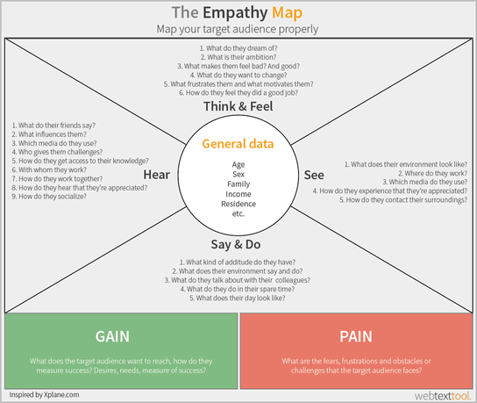

Slide 10
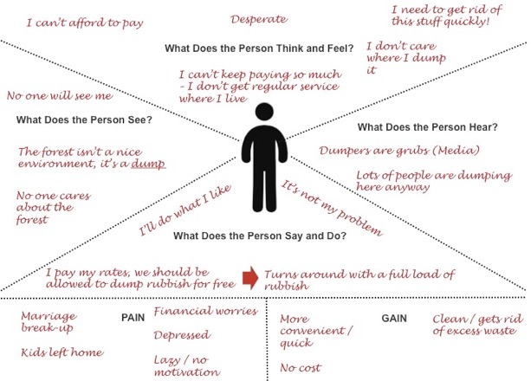

Slide 11
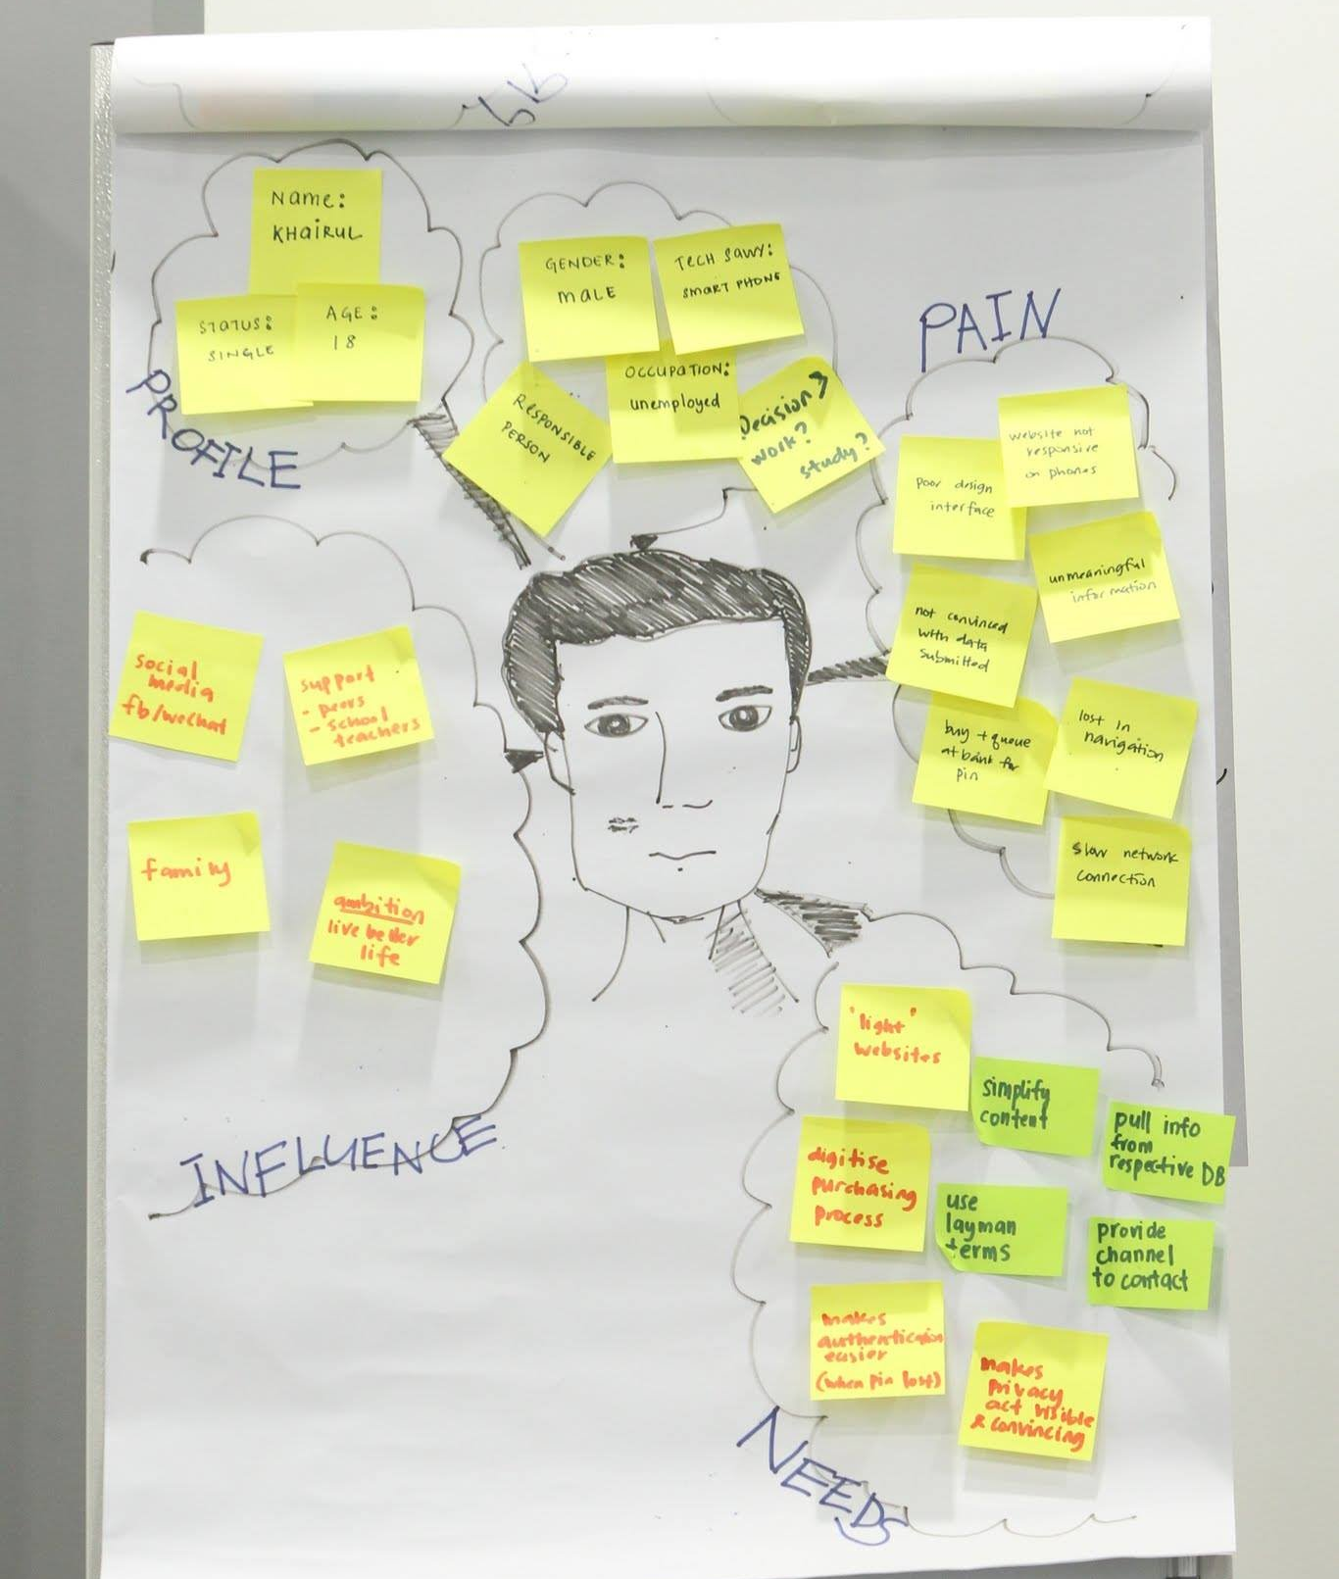
https://conceptboard.com/blog/create-a-customer-empathy-map-in-6-easy-steps/

Slide 12
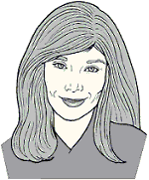
Example of a Person (1)
Nikki is 50 and works as a Doctor
in the Royal Melbourne Hospital.
She is a specialist in cardiology and
has over 18 years experience in that
field of research. She often uses
a computer tomography or ultrasound
machine. Nikki makes judgments
rationally. She wants the software
that comes with the medical devices to give her results fast and in graphical format with the opportunity to zoom things to the max. Nikki has a positive attitude in terms of technology as she has experienced it as a great support. She is confident using a computer even though he’s not an expert.

Slide 13
..from Nikki’s Persona Profile
Nikki’s goals when using the software, she
  wants the software that comes with the medical devices to give her results fast and in graphical format with the opportunity to zoom things to the max.

Slide 14
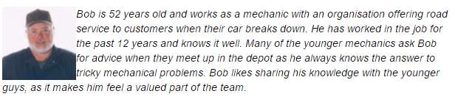
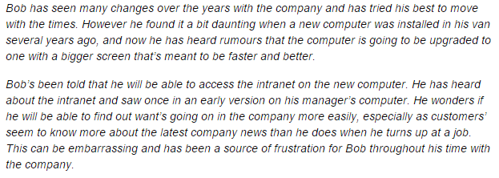
Example of a Persona (2)

Slide 15
..from Bob’s Persona Profile
Bob’s goals when using the internet
  wants to avoid feeling stupid
  would like to retain status as mentor
  make him more informed when interacting with customers

Slide 16
TASKS
ANALYSIS

Slide 17
What is a Task?
A task is a set of user actions to achieve a specific user goal, supported by the system.
The scope of a task depends on the user’s objective and the design context.
Tasks vary in size and complexity based on the goal and system requirements.

Slide 18
Task Analysis
Task descriptions: often used to envision new systems or devices
Task analysis: used mainly to investigate an existing situation
Means of analysing and describing the jobs people do
  Method and notation
A method/set of methods for understanding the tasks users carry out with a product/system
To analyse the underlying rationale and purpose of what people are doing; what are they trying to achieve, why are they trying to achieve it, and how are they going about it
Focus on
  User Analysis – involves learning about the user
  peoples’ goals and the actions they carry out
  things people know
  the things they act on
Can be used for many different purposes within design and evaluation activities
Many techniques, the most popular is Hierarchical Task Analysis (HTA)

Slide 19
Benefits of Task Analysis
Determine:
  The tasks the system has to support
  The scope of the system
Develop a
  Streamlined interaction method.
  Logical structured user interface
Create a system that reflects
  Users goals
  Tasks
  Workflow

Slide 20
What can we learn from task analysis?
User’s goals
How the user achieves their goals
Personal, social, and cultural characteristics that influence the user in doing their tasks
How the physical environment affects them in completing their tasks
How previous experience knowledge influence their thinking
How they approach work and the workflow they use to complete tasks

Slide 21
Data Collection: Where do tasks come from?
How can we find out about what people do this?
  Watch them
  Talk to them
  Read documentation, training material, etc.
  Do the task ourselves
  Become familiar with existing systems

Slide 22
Visiting Real Users
Important to analyse real tasks
  Not imaginary ones
  Not the task of the designer
Contextual inquiries
  Genuine studies of what real users do in the workplace
Task analysis is about gathering and analysing data

Slide 23
Question and Things to Consider
Questions to ask the user:
  What are the overall tasks you are trying to achieve?
  What process do you follow to complete the task?
  What likes and dislikes you have in the way you complete tasks?
Things to consider:
  Does the user efficiently complete the task?
  What other ways are their to complete the task?
  Is there a more efficient way?
Who are the users?
  Diversity
  Question people who don’t use the system
What do they do?
  What do they really do?
  Don’t give false goals
  Observe goals as well as tasks

Slide 24
Structured Task Analysis Process
Identify the task to be analysed.
Break this down into between 4 and 8 subtasks.
Draw the subtasks as a layered diagram
Decide upon the level of detail into which to decompose.
Validate the analysis with team members

Slide 25
Task Decomposition
Goal
state of the system that a human wants to accomplish.
activities required, used, or deemed necessary to achieve a goal.
steps required to complete the task.
Task
Actions

Slide 26
Hierarchical Task Analysis (HTA)
Involves breaking a task down into subtasks, then sub-sub-tasks and so on. These are grouped as plans which specify how the tasks might be performed in practice
HTA focuses on physical and observable actions, and includes looking at actions not related to software or an interaction device
Start with a user goal which is examined and the main tasks for achieving it are identified
Tasks are sub-divided into sub-tasks
Represent the goals, sub goals, operations and plans using either:
  graphical views (boxes and arrows)
  non-graphical methods (e.g. tabulation, outlines, textual)

Slide 27
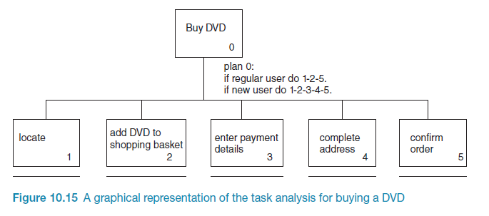
Example of HTA (Graphical)

Slide 28
Example of Textual HTA
0. In order to buy a DVD
1. locate DVD
2. add DVD to shopping basket
3. enter payment details
4. complete address
5. confirm order
plan 0: If regular user do 1-2-5.
If new user do 1-2-3-4-5.

Slide 29
Adding Plans
Hierarchical diagram / text specifies what subtasks are part of a task
Does not specify how the subtasks are carried out
Plans are used to describe
  order of subtasks
  conditional or optional subtasks
  repetition
  etc.
A plan needed for each decomposed task

Slide 30
HTA Example 1:
withdrawing cash from an ATM
Withdrawing cash from an ATM requires tasks from the user...
What are those tasks?

Slide 31
HTA Example 1 Textual Presentation
    0 Withdraw cash
  1 Check machine will work
    1.1 Look at status indicator
    1.2 Look for card logo
  2 Insert card
  3 Enter PIN number
  4 Initiate withdrawal transaction
    4.1 Select withdraw cash
    4.2 Enter amount
  5 Complete transaction
    5.1 Take card
    5.2 Take cash
A plan needed for each decomposed task
  Plan 0: do 1; if possible do 2;
  repeat 3 until PIN correctly
  entered; do 4; do 5.
  Plan 1: do 1.1, 1.2 in any order
  Plan 4: do 4.1; do 4.2
  Plan 5: wait until card available;
  do 5.1; wait until cash
  available; do 5.2

Slide 32
HTA Example 2:
microwave oven
What is the overall goal?
  “Cook food!”
How is this done?
  Prepare meal
  Put meal in oven
  Select program
  Listen for bell to ring
  Remove meal
Selecting a programme - How is this done?
  Set to auto sensor
  Set to defrost
  Set timer to cook
What are the rules that influence the order in which tasks/subtasks take place? (the plans)

Slide 33
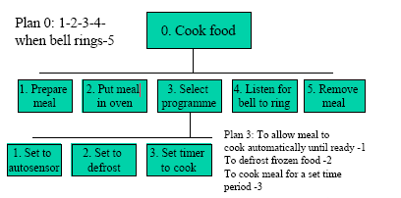
HTA Example 2 Graphical Presentation

Slide 34
HTA Example 3:
filing documents
The manual task of filing documents in a filing cabinet...
  You have an unsorted stack of documents
  Your filing cabinet contains folders that are ordered somehow
  How do you get all the documents into the correct folder?

Slide 35
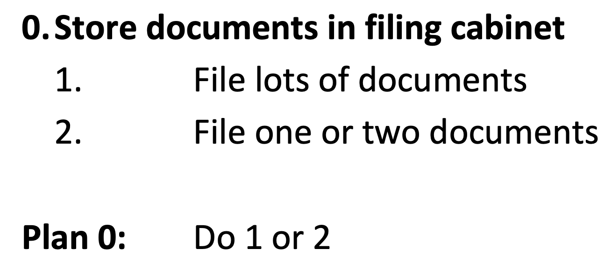
HTA Example 3:
… filing cabinet
You probably act differently if you have a lot of documents to file rather than a few...

Slide 36
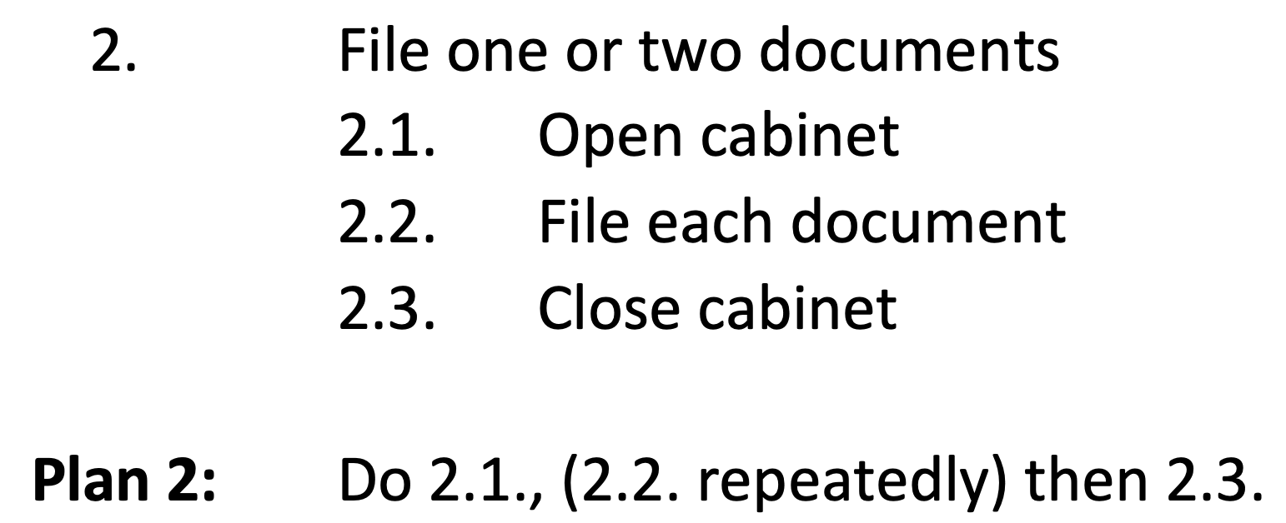
HTA Example 3:
… filing one or two things
Simply find the appropriate folder and put the documents in...

Slide 37
HTA Example 3:
… filing each document
  2.2. File each document
  2.2.1. Find appropriate file
  2.2.2. Open file
  2.2.3. Place document in file
  2.2.4. Close file
Plan 2.2: Do 2.2.1, 2.2.2., 2.2.3., then 2.2.4.

Slide 38
HTA Example 3:
… filing lots of document
Sort the documents into order first
then split the sorted documents up into ‘categories’ (i.e. all the documents whose author begins with ‘A’)
then work through the filing cabinet, putting each category into the right file
1. File lots of documents
1.1. Choose criteria on which documents are sorted
1.2. Sort all documents to be filed into order
1.3. Split documents up into categories
1.4. Open cabinet
1.5. Place each category of document into file
1.6. Close cabinet
Plan 1: Do 1.1., 1.2., 1.3., 1.4., (1.5. repeatedly) then 1.6.

Slide 39
HTA Example 3:
… choosing sorting criteria
1.1. Choose criteria on which documents are sorted
1.1.1. Choose alphabetical by title of document
1.1.2. Choose alphabetical by author of document
1.1.3. Choose date order
Plan 1.1: Do any one of 1.1.1., 1.1.2., or 1.1.3.

Slide 40
HTA Example 3:
… placing categories in files
1.5. Place each category of document into file
1.5.1. Open file
1.5.2. Place each document in file
1.5.3. Close file
Plan 1.5: Do 1.5.1., (1.5.2. repeatedly) then 1.5.3.

Slide 41
Things to Note
The overall task is numbered 0
The tasks are all described by verbs
Each task that is decomposed must have a plan to go with it
Plan X must only refer to sub-tasks to X

Slide 42
Reflecting on HTA Example 3
Imagine that you are designing an electronic filing system...
What does this HTA tell you about filing systems?
Which bits of the manual task would you keep, and which would you do away with or redesign?
Why?

Slide 43
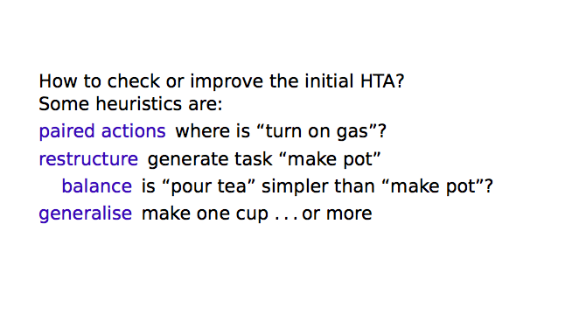
HTA Supports Refinement

Slide 44
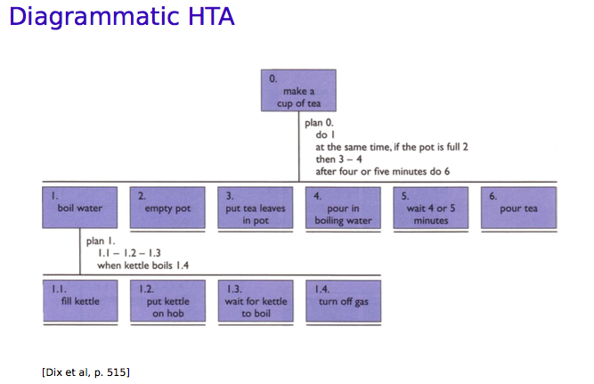
HTA Example 4:
making tea

Slide 45
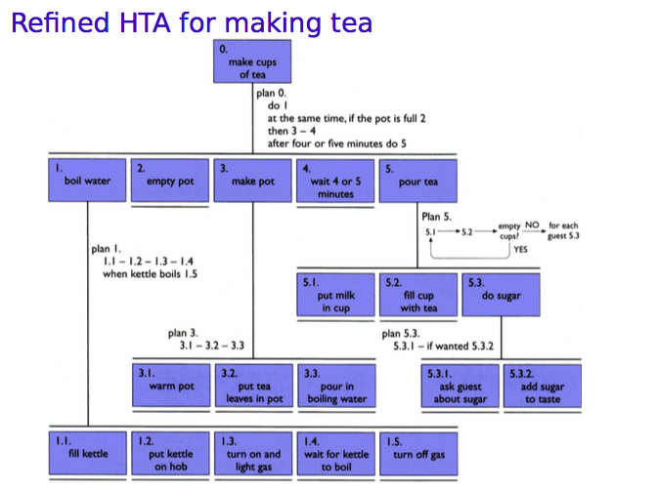
HTA Example 4:
… refined HTA for making tea

Slide 46
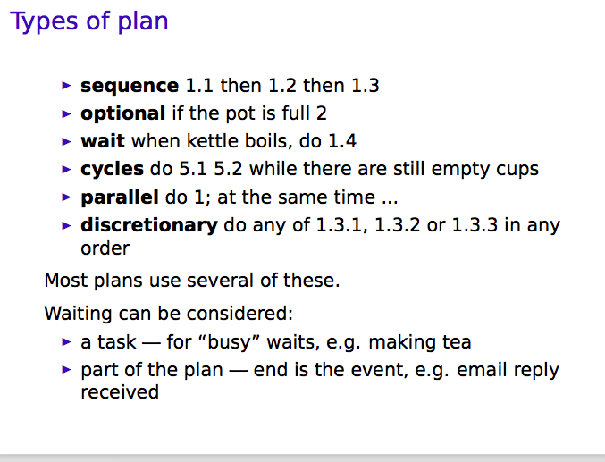
HTA Example 4:
… types of plan

Slide 47

Activity
Jill creates a stack of new catalogues in a corner of her kitchen. When she is preparing dinner, she can flip through a catalogue to see what’s new or on sale or what strikes her interest. In the evening she may pick out five or six catalogues to look at while the family is watching TV. She may even take a few to bed, or to the bath.
Generally she simply browses through pictures, reading descriptions only when the pictures look interesting. When she finds something interesting she may dog-ear the page, draw a circle round it or mark the page with a sticky note. She keeps catalogues with marked pictures around until she wants to make a purchase.

Slide 48
Sample Solution
0. Using catalogues
1. Browse items
2. Mark items
0. Using catalogues
1. Browse items
2. Mark items
2.1. Circle item
2.2. Mark page
2.2.1. Dog-ear page
2.2.2. Sticky on page
0. Using catalogues
1. Browse items
1.1. Browse by what’s new
1.2. Browse by sales
1.3. Browse by items that interest
1.4. Browse by catalogues
1.4.1. Browse in kitchen
1.4.2. Browse while watching TV
1.4.3. Browse in bed
2. Mark items
The source doesn’t say much about how the tasks are done, but…
Plan 0: do 1 then 2 if item found
Plan 1: do 1.1 or 1.2 or 1.3 or 1.4
Plan 2: do 2.1 or 2.2

Slide 49
Reflecting the Activity
What does this tell us?
  Need flexible system
  Need portable system
  Need system that allows lots of different browsing criteria
  Possibly need to improve system for marking selected items
These are passed as requirements to the design cycle

Slide 50
WRITING
A SCENARIO

Slide 51
What is a Scenario?
A narrative description that describes how a user is intending to use a system
Goal or Task-based
Can include textual descriptions, illustrated stories, animations or even videos
Presents the user's point of view

Slide 52
Benefits
Highlights an application within the work context
Powerful communication tool
Useful for testing of early prototypes
Helps users understand the design
Provides a contextual basis for testing
Scenarios test the integrity of requirements and processes
Gives an idea of current and future needs

Slide 53
Writing Scenario Process
Analysis
Analyze
Stakeholders
Field Studies
Claims about
current practice
Problem Scenarios
Design
Metaphors,
information
technology,
HCI theory,
guidelines
Activity Scenarios
Information Design Scenarios
Interaction Design Scenarios
Iterative analysis
of usability claims
and redesign
Prototype & Evaluation
Formative
evaluation
Summative
evaluation
Usability Specifications

Slide 54
How to Write a Scenario?
Determine the target group and analyse their context of use
Transform user goals into activities
Determine the user tasks, and the system tasks.
List in dot point the sequence of tasks
Re-write task list into simple narrative language.
Ensure you omit in your wording, any links to the technology
Review the scenario to ensure it represents a real use context.

Slide 55
How to Write a Scenario?
for using the ATM
Persona:
  Brad, 45, carefree office worker, travel often but does not have good time management
User goal:
  Withdraw money quickly from the ATM
Tasks :
  Identify himself
  Key in the transaction details
  The system responds
  Transaction ends

Slide 56
Writing the Text-based Scenario
Re-write task list into simple narrative language
It's Thursday afternoon and Brad is flying to Sydney. He doesn't have enough money for a taxi to the airport, and he's running late. He goes to the local ATM and identifies himself. He specifies that he wants $200 from his savings account. He'd like the money in $50 notes so that he can give the taxi driver the correct change. He doesn't want a printed receipt, as he doesn't bother keeping track of transactions in this account, besides he’s already late. The system draws out his money, and the transaction ends.
Ensure you omit in your wording, any links to the technology
Review the scenario to ensure it represents a real use context

Slide 57
Summary
Scenarios, use cases and essential use cases can be used to articulate existing and envisioned work practices.
Task analysis techniques such as HTA help to investigate existing systems and practices
Task analysis gives designers a means of describing how people do their jobs
Serves different purposes in design and development

